Slide 1
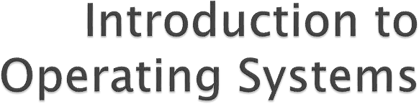

Lecture 1
By: Farah Jabeen

Slide 2
Objectives
What is Operating System
Definitions of Operating System
Boot Strapping
Introduction to common Operating Systems

Slide 3
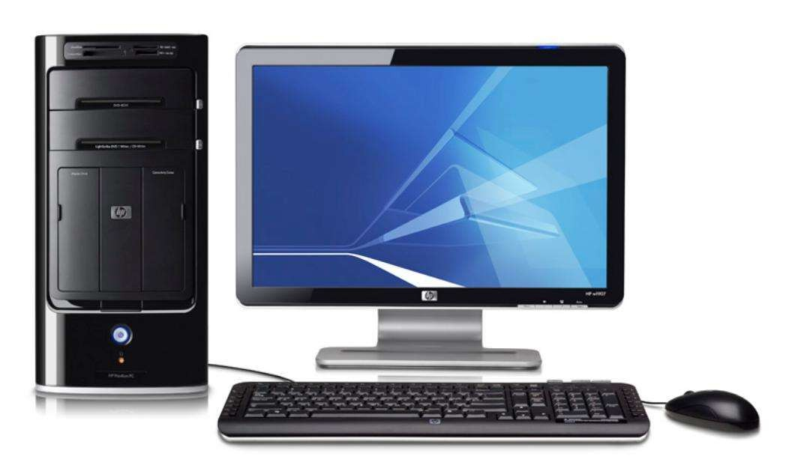

Slide 4
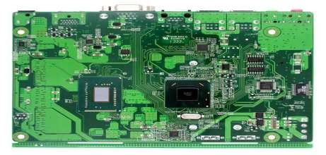
Computer Hardware

Slide 5
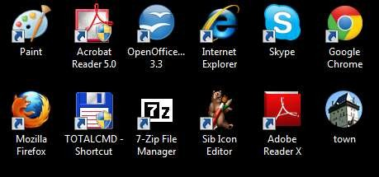
Software Applications
Computer Hardware

Slide 6
Software Applications
OPERATING SYSTEM
Computer Hardware

Slide 7
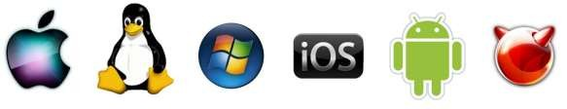

Software Applications
OPERATING SYSTEM
UNIX
Computer Hardware

Slide 8
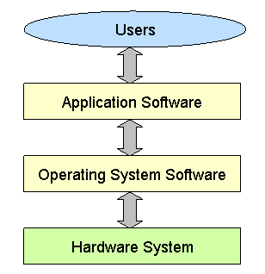
What is operating system?
Definition:
An operating system (OS) is a collection of software that manages computer hardware resources .
Without a computer operating system, a computer would be useless
“The operating system acts as a Interface Between the user and computer hardware”

Slide 9
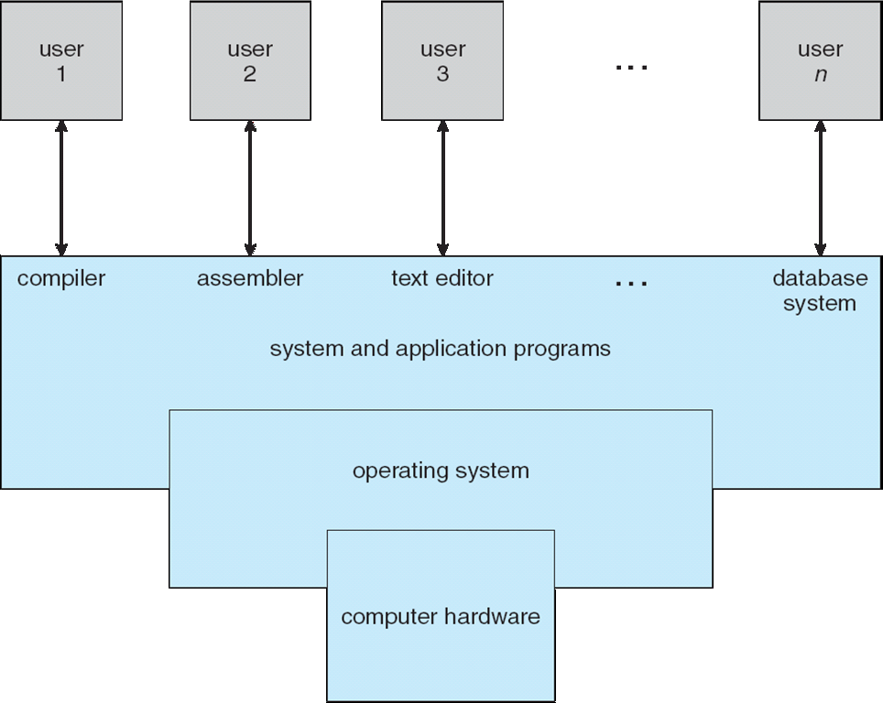
Definition of Operating System
A program that acts as an intermediary between a user of a computer and the computer hardware

Slide 10
Operating System Definition
OS is a resource allocator
Manages all resources
Decides between conflicting requests for efficient and fair resource use
OS is a control program
Controls execution of programs to prevent errors and improper use of the computer
I/O is accessed via Operating Systems

Slide 11
Operating System Definition (Cont.)
No universally accepted definition
“Everything a vendor ships when you order an operating system” is a good approximation
But varies wildly
“The one program running at all times on the computer” is the kernel.
Everything else is either
a system program (ships with the operating system) , or an application program.

Slide 12







Operations Of OS
Start and shut down a computer
Provide a user Interface
Manage Programs
Coordinate Tasks
Configure Devices
Manage Memory
Establish An Internet Connection
Control a network
Provide Utilities

Slide 13
Computer Startup
bootstrap program is loaded at power-up or reboot
Typically stored in ROM or EPROM, generally known as firmware
Initializes all aspects of system
Loads operating system kernel and starts execution

Slide 14
Some common Operating Systems

Slide 15


UNIX
Whose logo is this?

Slide 16

UNIX
Developed by Ken Thompson and Dennis Ritchie
Unix was launched in 1969
It is a CLI (Command-Line Interface)
Written in the C programming language
Led to a variety of academic and commercial variants, e.g. University of California, Berkeley (BSD), Microsoft (Xenix), IBM (AIX) and Sun Microsystems (Solaris)

Slide 17
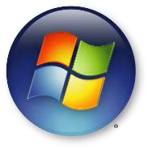
Whose logo is this?

Slide 18

Developed by Microsoft - Bill Gates & Paul Allen
Windows was launched in 1985
Built on DOS (Disk Operating System), which is a CLI (Command-Line Interface)
Has two modes User Mode (the user cannot directly access the hardware) and Kernel Mode (the user can access the hardware)
Runs on Computers, Tablets (Surface), and integration with Xbox

Slide 19
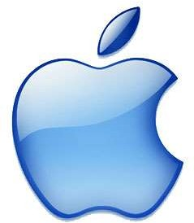
Whose logo is this?

Slide 20
Developed by Apple - Steve Wozniak & Steve Jobs
MacOS was launched in 1984
MacOS is a native GUI (Graphical User Interface)
MacOS evolved into OS X, which combined technologies from MacOS, Unix, and NeXT
Runs on Computers and other devices.

Slide 21
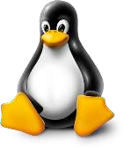
Whose logo is this?

Slide 22

Developed by Linus Benedict Torvalds
Linux was launched in 1992
Linux is a CLI (Command-Line Interface)
Torvalds made the code of Linux freely available to everyone on the internet, and therefore lots of people created their own versions of Linux, e.g.
Debian, RedHat, SUSE, SlackWare, Gentoo, Ubuntu

Slide 23

Whose logo is this?

Slide 24

Developed by Andy Rubin, Rich Miner, Nick Sears,
and Chris White
Android was launched in 2003
Based on the Linux kernel
Android is a GUI designed primarily for touchscreen mobile devices such as smartphones and tablets

Slide 25
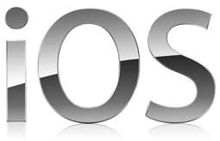
Whose logo is this?

Slide 26

Developed by Steve Jobs and Scott Forstall
iOS was launched in 2007
Based on the MacOS
iOS is a GUI designed primarily for touchscreen mobile devices such as iPhones, iPods, iPads, and AppleTV.

